Slide 1
GSA Schedules 101
Speaker: Richard White
Fedmarket
President, CEO
rwhite@fedmarket.com
888-661-4094, Ext. 5813
A copy of this presentation will be emailed to you after the broadcast.

Slide 2

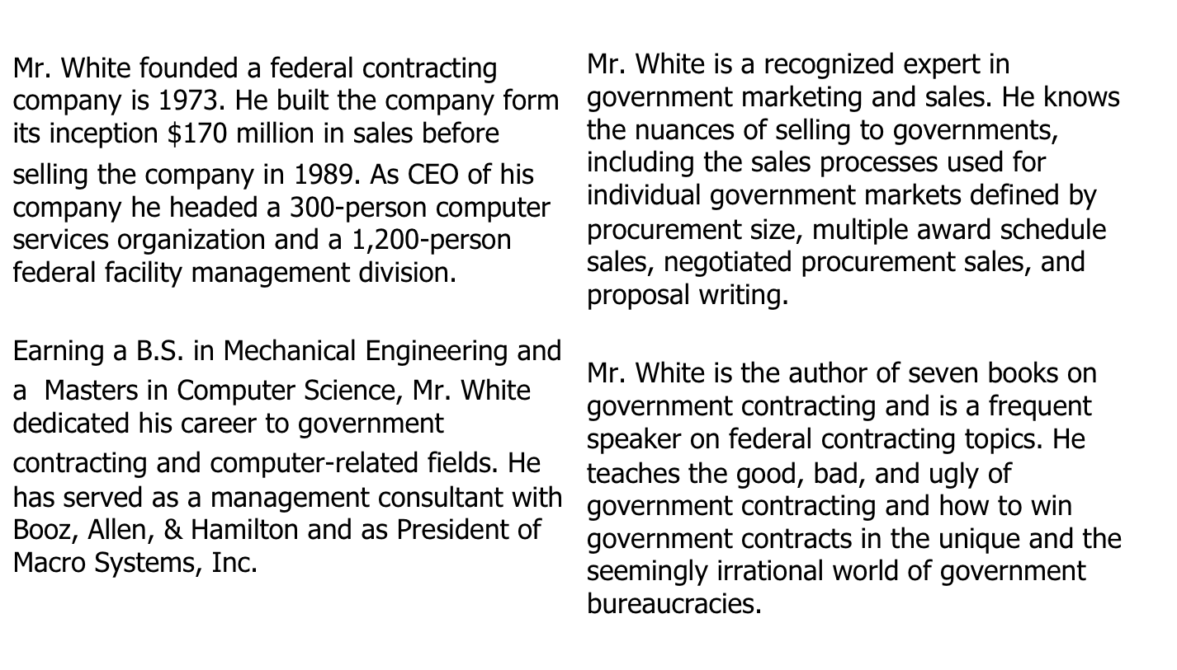
Richard White

Slide 3
Realities of Winning Government Contracts
Open competition is too expensive and time consuming for most federal purchases. The government would grind to a halt if open competition were used for every purchase.
Federal buyers cannot just purchase a product of service without following rules concerning the amount of competition required. Limited competition is allowed by the Federal Acquisition Regulations.
The government can no longer afford to purchase thru single award solicitations so they are turning to Multiple Award Contracts (MACs) for most of their purchases.

Slide 4
What are MACs
Multiple Award Contracts (MAC’s) have the following characteristics:
Awards are made to a number of vendors and the winning vendors compete among
themselves for business.
Task Orders or Requests for Quotes (RFQ’s) are issued to one or more of the vendors to
meet specific agency requirements; usually three.
Approved vendor price lists are negotiated as part of the proposal evaluation and
award process.
The price lists become part of the contract and are used to price Task Orders or RFQ’s.
The percentage of federal purchases made through multiple award contracts will increase
dramatically in the future.
Multiple award contracts have always been popular with end users because end users
can buy what they need quickly.

Slide 5
MAC Facts
The number of MACs awarded by the government now exceeds
5,000 and the number is growing every day.
GSA schedules are MACs.
GSA schedules have two important characteristics:
They are government-wide contracts that can be used by
any agency or buyer.
They are always open for a bid (proposal).

Slide 6
What are GSA Schedules?
Federal contracts with multiple vendors, with pre-approved prices for their products and services (Multiple Award Contract).
The Sears Catalogue of federal contracting.
The contract is not funded until an order is placed.
Orders are placed against the vendors’ catalogue when the need arises.
GSA schedules represent about 20 % of all new federal contracts.
$ 60 plus billions a year is ordered through schedules.

Slide 7
What are GSA Schedules continued…
40 Specific GSA Schedules cover almost all products and services offered commercially. (A company usually needs one of the 40 schedules to sell their products and services).
Schedules may be used by any federal agency anywhere in the world and by state and local government in selected cases.
Around 21,000 vendors now hold GSA schedule contracts (more later on why that shouldn’t scare you).

Slide 8
More on schedules
5 Year firm contracts with three, five-year option periods for a total of 20 years
Option years are usually exercised if you have sales through the contract
Contract cancelled if you don’t have $ 25,000 of cumulative sales over the first 2 years of the contract

Slide 9
More on schedules
5 Year firm contracts with three, five-year option periods for a total of 20 years
Option years are usually exercised if you have sales through the contract
Contract cancelled if you don’t have $ 25,000 of cumulative sales over the first 2 years of the contract

Slide 10
Why do schedules exist?
GSA schedule contracts provide buyers with an approved method within federal purchasing rules that:
  Limits competition
  Avoids lengthy and costly public procurements
  Allows a purchase to be quickly
What if your business had to wait 270 days to make a purchase?

Slide 11
Why do schedules exist continued…
GSA Schedules are the oldest and largest of thousands of Multiple Award Contracts (MACs).
Other MACs are only open for bids for a set period (30 – 60 days) and then close. This shuts out any companies who did not receive an award.
Always open for a proposal from small businesses and businesses new to the federal market (this feature is unique to GSA schedules).

Slide 12
Unique Features of GSA Schedules
Always open for a proposal
40 schedules cover almost every commercial product and service
A/E services and construction are exceptions
GSA uses your own commercial pricing to negotiate GSA prices

Slide 13
What are the qualifications criteria for obtaining a schedule contract?
2 years in business
Services – have sold the service
Products - have a published price list
Decent financial condition (can you make payroll?)
Most business can be reasonably confident that they will receive a GSA schedule award if they meet the above criteria.
Resubmittal of proposals: It is never over

Slide 14
Which GSA Schedule is right for your business?
Analyze the schedule scopes of work and select the appropriate schedule(s) for your company.
Call your Fedmarket salesperson if you are unsure.
A/E services and construction are only allowed on GSA schedules under special circumstances.
The Office Supply schedule is closed until further notice.
Custom products can be a problem, but solvable with options and features.
Call Richard White (301) 908-0546 for assistance.

Slide 15
Should my company invest in a GSA schedule contract?
How much money is really contracted through GSA sales? See: GSA Sales by Schedule
  IT 17.2 billion (state and local use authorized)
  Engineering 5.2 billion
  Furniture 1.6 billion
  Hardware and industrial products 1.3 billion
  Financial services 1.4 billion
  Management consulting and training 2.9 billion
  Law enforcement products 2.6 billion (state and local use authorized)

Slide 16
Should my company invest in a GSA schedule contract? continued..
Realize the following market realities:
  Need for a focused sales program
  Most services are sold, not ordered
  Commodities can be ordered
  Focus is the key
Have government customers? Ask them.
No government customers, find one or more Contracting Offices, visit them, and ask about their use of GSA schedules.
Without a schedule you can be shut out of a government market.

Slide 17
Should my company invest in a GSA schedule contract? continued..
GSA schedules are ideal for small businesses.
  Always open for a proposal
  New small business set-aside rules
  Make a value judgment knowing that you must have a focuses sales program

Slide 18
Ordering and Competition
Why 20,000 schedule holders should not concern you:
  1,400 SINs across 40 Individual GSA Schedules.
  About 40 % of all schedule holders have sales of less than $25,000 last fiscal year and GSA is planning to cancel 8,000 no-sales contracts.
  For products and most services you will probably only going to be competing with 3 – 10 companies since almost all bids are for a specific SIN.

Slide 19
GSA schedule competition in real life
Pre-selling is encourage by the federal government and the buyers don’t tell you who they have met with.
Advanced sales cause most bids to be predetermined (you generate demand).
For the file they need to receive 3 bids.
Some bids are broadcast thru eBuy and eBuy RFQs and may have been pre-sold.

Slide 20
Finding detailed GSA schedule information
Available Public Information:
  GSA schedule descriptions and solicitation documents
  Organizations authorized to use GSA schedules
  GSA schedule vendors and their prices
  Who are the vendors winning GSA contracts? (GSA schedule sales by quarter)
  Fedmarket GSA schedule competitor sales search tool

Slide 21

Why do buyers like GSA Schedules?
  Fast and easy purchasing
  They limit competition under the rules
  Eliminates the need for a public bid
  They cover almost all industries

Slide 22
Why do vendors like GSA Schedules (and other IDIQs)?
Vendors like them because buyers like them
Schedules limit competition, which is a salesperson’s dream
State and local use
  Official use
  Unofficial use
Buyers like them

Slide 23
GSA Pricing
Can I change my GSA pricing after the award?
  Yes, through contract modifications.
  Several are allowed a year but most companies do annual modifications.
  Service companies have less problems with price changes than product companies.
  Dealing with price volatility.

Slide 24
The GSA Proposal – Key Factors
What are the key factors to writing a proposal that GSA will approve?
  150+ pages
  10 – 20 files depending on the specific schedule
  2 critical files that are the core of every GSA schedule proposal: discount disclosures and proposed GSA pricing based on discounting disclosures

Slide 25
The GSA Proposal - Key Factors continued
Discount Disclosures
  Disclosures are required to document your discounting policies and most favored customers.
  Your proposed GSA pricing is negotiated based on your commercial pricing.
  Market discounting is allowed but GSA seeks the most favored customer.
  Written discounting policies are rare and informal discounting must be explained.
  Call your Fedmarket sales person if in doubt.

Slide 26
The Evaluation and Award Process
150 page proposal, 10 pages of discount disclosures and proposed pricing tables and the 140 pages of red tape
eOffer (GSA submittal site) requires a digital certificate
In 1 – 4 weeks you will receive an email that states that GSA has your proposal and provides contact information for the GSA proposal evaluator.
Average evaluation times are 3 – 4 months (accelerated evaluations of about 1 month can be arranged with an email from a federal buyer).
Refinements, rejections, negotiations, award, and then upload prices to the GSA schedule pricing database.

Slide 27
Price Offer and Negotiation
Price offers are based on written discounting policies.
Discounting is much more critical for product companies.
$100 product example.
Volume discounting may be offered.
Regional pricing is accepted.
Huge price lists are handled with Excel spreadsheets.
Services pricing is normally based on hourly labor rates.

Slide 28
Proving Corporate Capabilities
The critical part of the Technical Proposal to GSA is the requirement for several project descriptions (summaries of project level corporate experience).
The remaining parts of the technical proposal are red tape items.
Writing summaries of corporate experience to prove your company’s capabilities are often a problem for service companies new to the market.

Slide 29
How long? How much?
How long will it take me and how much will it cost us to get on a GSA Schedule?
  Fedmarket’s services to prepare a GSA schedule proposal range from $ 3,000 to $ 12,000 depending on the scope of the services.
  Elapsed time from proposal to award: 6 months plus, but can be shortened
  Federal agency call ins can shorten evaluation time after proposal submittal to one month.
Preparing a GSA schedule proposal is like preparing a corporate income tax return.
The danger of low GSA service bids; would you select a heart surgeon based on low cost?
BEWARE: A contract award cannot be guaranteed!

Slide 30
Selling using GSA Schedules
Sell in the same way you do in the commercial sector
Recognize that for other than commodities you must generate demand
Find out who buys what you sell (database research)
Conduct sales 101
It’s not easy but focus is the key

Slide 31
Downsides of Schedules
Investment to obtain a schedules, $ 3,000 to 10,000
You lose your investment if you don’t use them to sell
Example:
Corp of Engineers
Military base
Difficult to focus sales efforts in comparison to agency
specific MACs

Slide 32
Fedmarket’s GSA Schedule Solutions
Our GSA Schedule specialists enable you to submit a winning GSA Schedule proposal by providing you with the services and products below.
Full-Service GSA Proposal Preparation - GSA contract award services where Fedmarket handles all aspects of preparation, submission, and negotiation of the GSA Schedule proposal. After the proposal process we continue to support you in GSA contract administration and in designing and implementing a GSA sales program.
GSA Proposal Preparation Assistance - GSA contract award services where Fedmarket handles all aspects of writing your GSA Schedule proposal and you submit it to GSA for review and award.
GSA at Your Office - Our service is designed to allow you to complete the proposal without leaving your office. In addition, it allows you to involve just the right individuals in the GSA Schedule proposal writing process: those that have domain expertise in pricing, sales, operations and administration.
GSA in Ten Days - GSA in Ten Days is an outstanding value. There is no travel, no guess work, and minimum impact on your work day.

Slide 33
Other Fedmarket GSA Templates, Products and Services:
GSA Proposal Wizard – GSA solicitation template with step-by-step instructions to write your own GSA proposal.
GSA Templates - Individual GSA proposal sections ready for inclusion in your proposal.
GSA Proposal Review - Fedmarket takes your incomplete or rejected GSA schedule proposal and transforms it into a proposal written to win a GSA Schedule contract award.
GSA Contract Manager – Manages all aspects of GSA contract compliance, each required task includes step-by-step procedures in an online business process.
Call 888-661-4094, Ext.2 for more information on Fedmarket’s GSA offerings.

Slide 34
Free GSA Resources available from Fedmarket
An executive summary explaining how you would benefit from obtaining a GSA schedule is available by request. Call your salesperson for your copy, 888-661-4094, Ext.2.
GSA Whitepapers
GSA Newsletters
GSA Play 20 Questions
GSA Schedules: The Shortest Path to Federal Dollars
(free download)
Six Reasons Why You Do Not Want to Write Your Own GSA Schedule Proposal

Slide 35
Other Available Complimentary Book Downloads
Rolling the Dice in DC: How the Federal Sales Game is Really Played
Cracking the $500 Billion Federal Market: The Small Business Guide to Federal Sales
Loading the Dice in DC, Legally: Learn the Politics and Realities of Federal Contracting
Government Contracting for Donkeys

Slide 36
Free Product Trials
IDIQ Search Engine - 30 Day Free Trial
Fedmarket offers a range of paid seminars taught by Richard White covering topics such as GSA schedules, federal sales and proposal development. View Fedmarket’s calendar for seminars and dates.

Slide 37
About Fedmarket
Fedmarket assists companies in obtaining federal contracts by providing training and consulting services and online market intelligence services.
  Training
  Proposal writing
  Buyer contact lists (standard and customized for your company)
Please call me at personally at 301.908.0546 if you would like to discuss any aspect of federal sales, or call Fedmarket’s sales team at 888-661-4094, Ext. 2.
  Richard White
  Fedmarket
  301.908.0546
  rwhite@fedmarket.com

